Slide 1
Chapter 10:
File-System Interface

Slide 2
Chapter 10: File-System Interface
File Concept
Access Methods
Directory Structure
File Sharing

Slide 3
File Concept
Contiguous logical address space
Types:
  Data
    numeric
    character
    binary
  Program

Slide 4
File Structure
None - sequence of words, bytes
Simple record structure
  Lines
  Fixed length
  Variable length
Complex Structures
  Formatted document
  Relocatable load file
Can simulate last two with first method by inserting appropriate control characters
Who decides:
  Operating system
  Program

Slide 5
File Attributes
Name – only information kept in human-readable form
Identifier – unique tag (number) identifies file within file system
Type – needed for systems that support different types
Location – pointer to file location on device
Size – current file size
Protection – controls who can do reading, writing, executing
Time, date, and user identification – data for protection, security, and usage monitoring
Information about files are kept in the directory structure, which is maintained on the disk

Slide 6
File Operations
File is an abstract data type
Create
Write
Read
Reposition within file
Delete
Truncate
Open(F_{i}) – search the directory structure on disk for entry F_{i}, and move the content of entry to memory
Close (F_{i}) – move the content of entry F_{i} in memory to directory structure on disk

Slide 7
Open Files
Several pieces of data are needed to manage open files:
  File pointer: pointer to last read/write location, per process that has the file open
  File-open count: counter of number of times a file is open – to allow removal of data from open-file table when last processes closes it
  Disk location of the file: cache of data access information
  Access rights: per-process access mode information

Slide 8
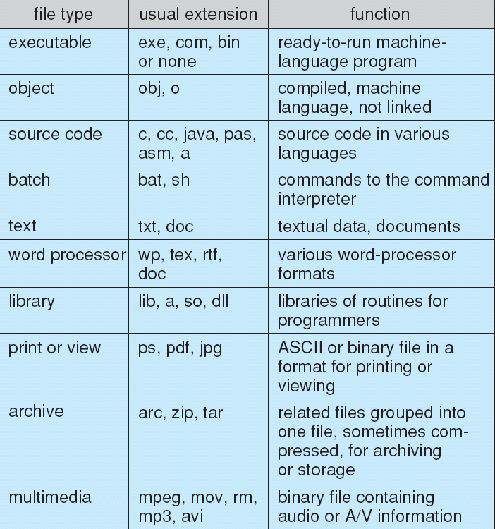
File Types – Name, Extension

Slide 9
Directory Structure
A collection of nodes containing information about all files
Directory
Files
F 1
F 2
F 3
F 4
F n
Both the directory structure and the files reside on disk
Backups of these two structures are kept on tapes

Slide 10
Operations Performed on Directory
Search for a file
Create a file
Delete a file
List a directory
Rename a file
Traverse the file system

Slide 11
Organize the Directory
(Logically) to Obtain
Efficiency – locating a file quickly
Naming – convenient to users
  Two users can have same name for different files
  The same file can have several different names
Grouping – logical grouping of files by properties, (e.g., all Java programs, all games, …)

Slide 12
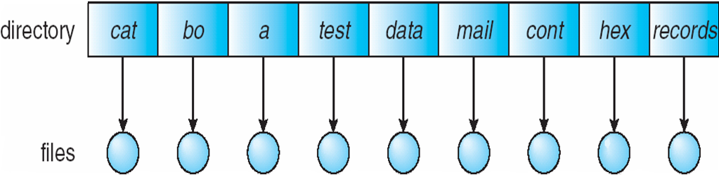
Single-Level Directory
A single directory for all users
Naming problem
Grouping problem

Slide 13
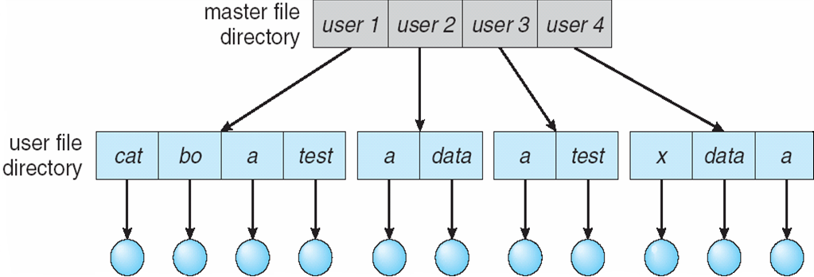
Two-Level Directory
Separate directory for each user
Path name
Can have the same file name for different user
Efficient searching
No grouping capability

Slide 14
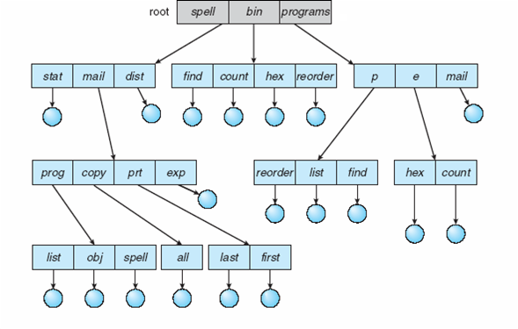
Tree-Structured Directories

Slide 15
Tree-Structured Directories (Cont.)
Efficient searching
Grouping Capability
Current directory (working directory)
  cd /spell/mail/prog
  type list

Slide 16
Tree-Structured Directories (Cont)
Absolute or relative path name
Creating a new file is done in current directory
Delete a file
rm <file-name>
Creating a new subdirectory is done in current directory
  mkdir <dir-name>
Example: if in current directory /mail
mkdir count
mail
prog
copy
prt
exp
count
Deleting “mail” ⇒ deleting the entire subtree rooted by “mail”

Slide 17
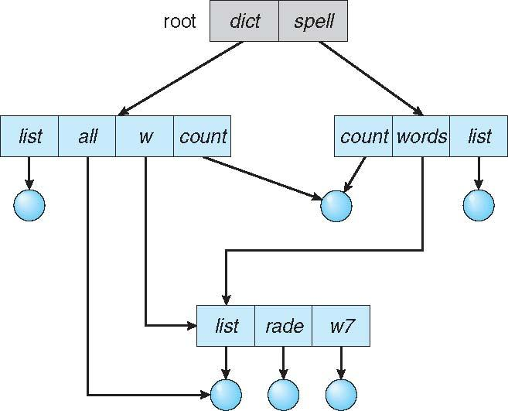
Acyclic-Graph Directories
Have shared subdirectories and files

Slide 18
Acyclic-Graph Directories (Cont.)
Two different names (aliasing)
If dict deletes list ⇒ dangling pointer
Solutions:
  Backpointers, so we can delete all pointers
  Variable size records a problem
  Backpointers using a daisy chain organization
  Entry-hold-count solution
New directory entry type
  Link – another name (pointer) to an existing file
  Resolve the link – follow pointer to locate the file

Slide 19
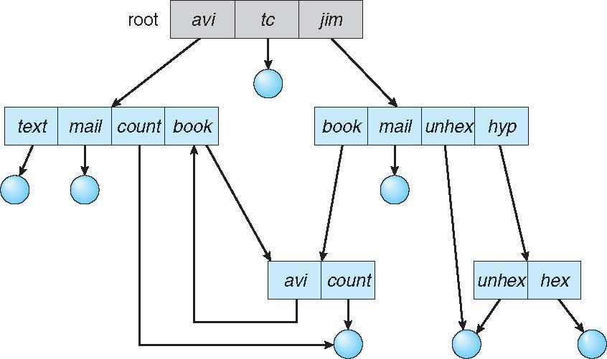
General Graph Directory

Slide 20
General Graph Directory (Cont.)
How do we guarantee no cycles?
  Allow only links to file not subdirectories
  Garbage collection
  Every time a new link is added use a cycle detection algorithm to determine whether it is OK

Slide 21
End of Chapter 10

